Slide 1





Seeds: The Interaction of Seed Technology and Mechanization
June 2014
www.bioprotection.org.nz
New Zealand
Experience
John Hampton¹ and John Stevens²
¹ Lincoln University Seed Research Centre,
Lincoln, New Zealand
² Flexiseeder Ltd, Lyttelton, New Zealand

Slide 2
Bio-protection Research Centre⁺
Hosted at Lincoln University
Canterbury, New Zealand
www.bioprotection.org.nz
⁺ One of 7 National Centres of Research Excellence
⁺ Includes the LU Seed Research Centre which is
the NZ contact point for IAMFE
Centre partners: Lincoln University, Massey University, AgResearch*, Plant and Food Research*, Scion* (Forestry) NB: *Crown Research Institutes
Enables and leads integrated research programmes,
which would not be possible from the partner
institutions working individually
Collaborates with many local and international,
research entities and companies

Slide 3
When seed quality fails to match the performance capacity of the seeding equipment so that crop establishment is poor ….
THE BLAME IS USUALLY PLACED ON THE EQUIPMENT AND/OR THE OPERATOR
NOT
THE SEED LOT!

Slide 4
Seeding equipment and seed quality are
linked together.
The development of seeding equipment
and supply of quality seed must always
meet the needs of the end-user.
The Seed Industry therefore requires:
- a fully operational Seed Chain
including
- improved seeding technologies.

Slide 5
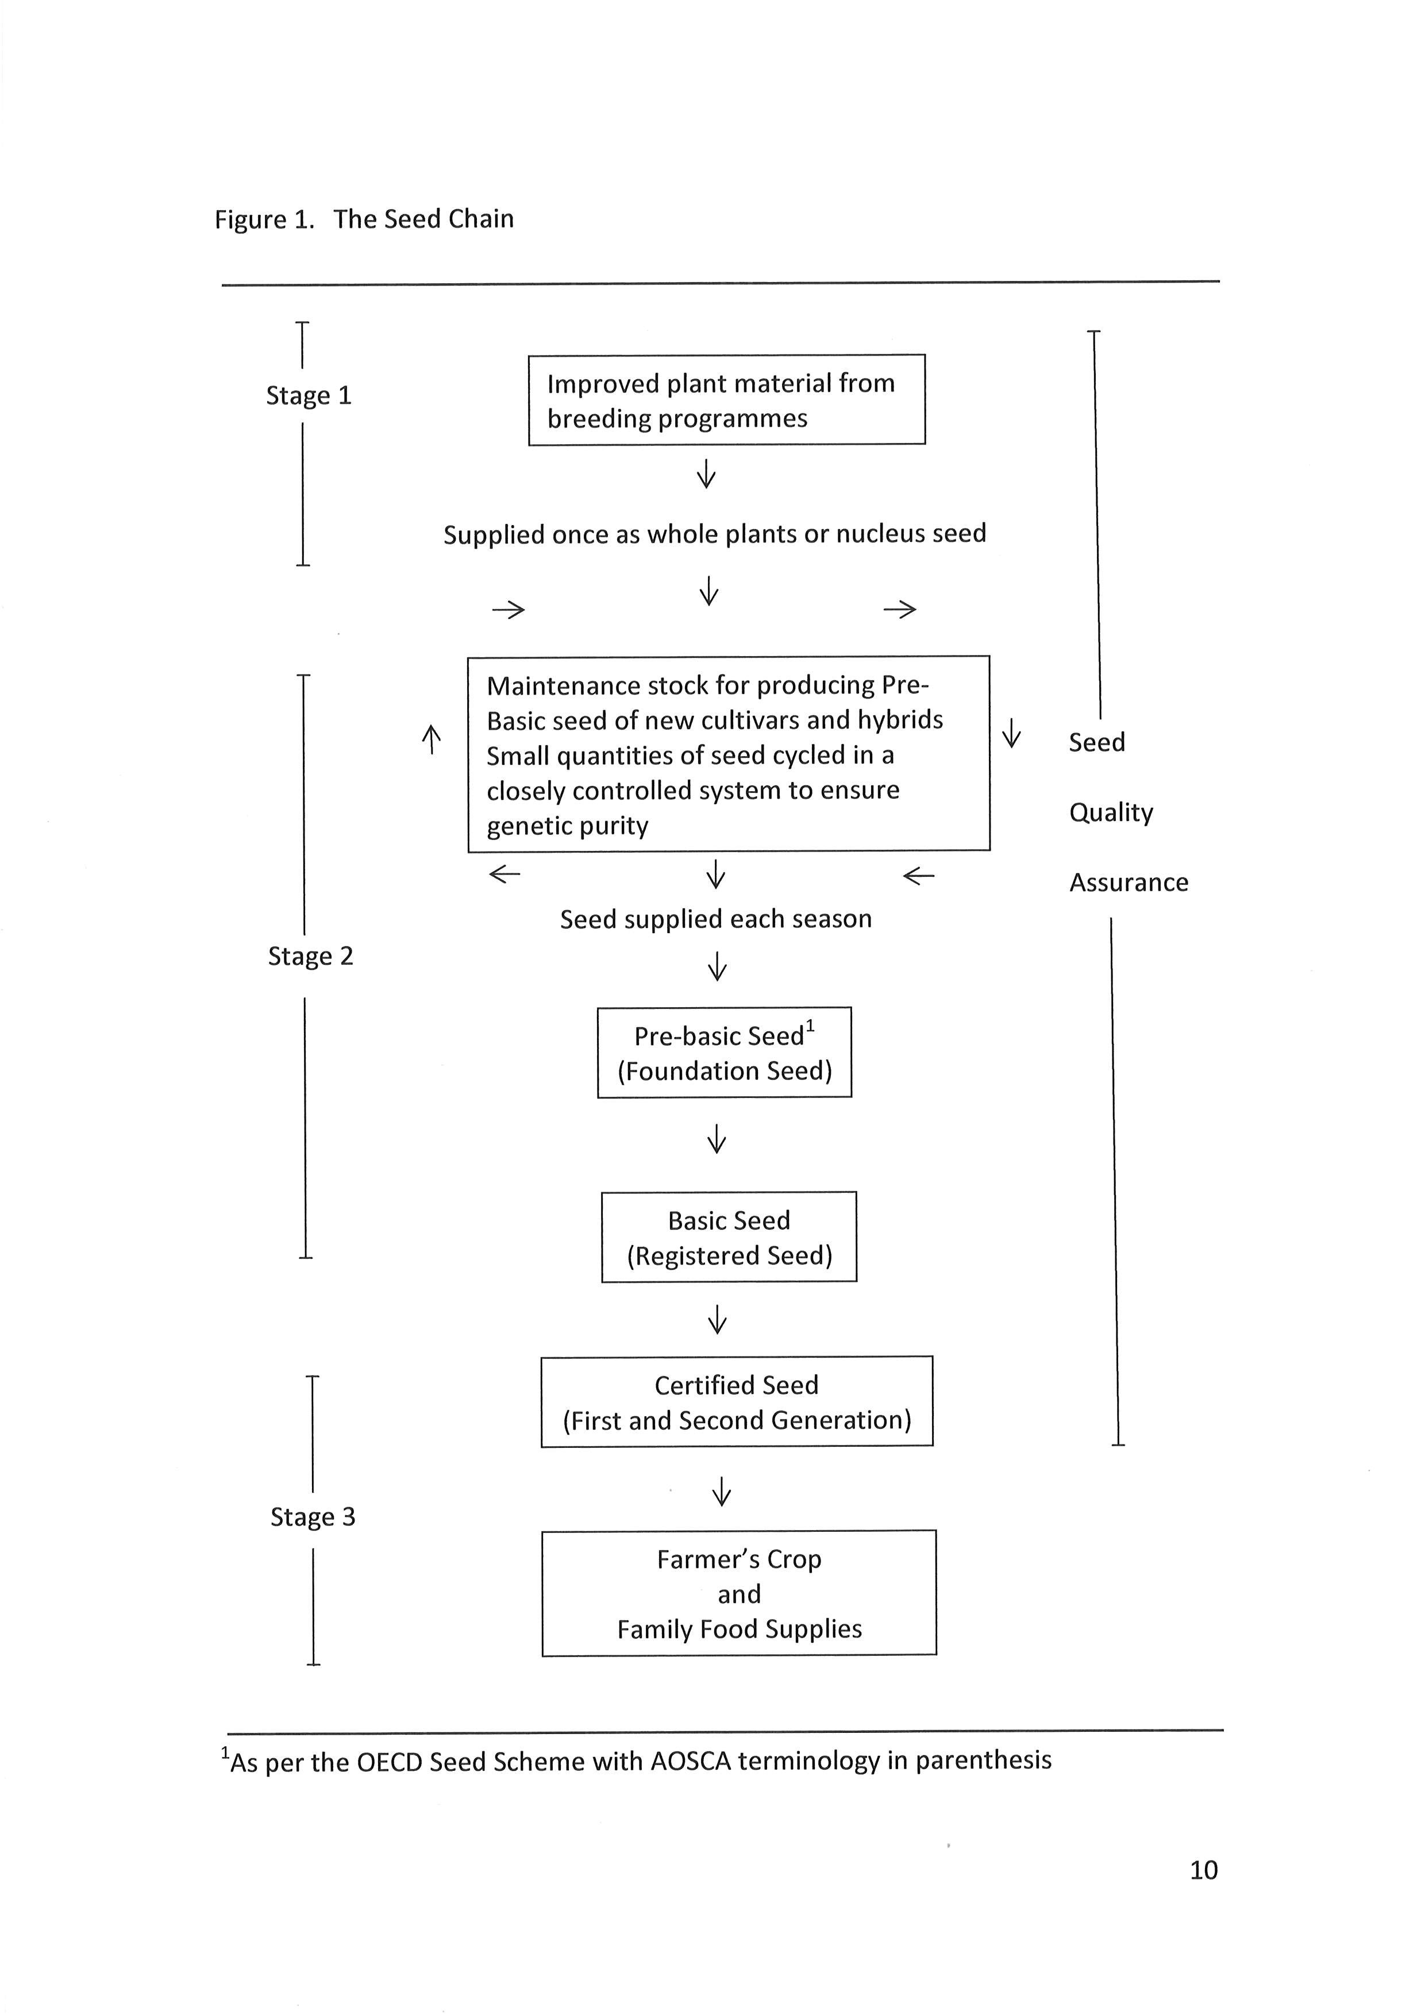
Seed Chain
NZ / Global
Rapid Globalization of Seed Trade
Global seed market:
worth USD 47b in
2012 - of which 9.9b
traded internationally
up from 4.5b in 2003
NZ a significant
player – some areas
(Ref: Int. Seed Federation).

Slide 6
The production and distribution of high quality seeds requires:
effective and efficient seed and machinery industry infrastructure
appropriate crop establishment methods.
skilled seed growers
good seed processing facilities
adequate short, medium and long-term storage facilities
excellent distribution systems
That is, an integrated system for ensuring that the required quantities of genetically pure seed are available when needed - via the Seed Chain

Slide 7
Throughout the three stages of the Seed Chain, seed
quality assurance (or control) measures are also
required to ensure:
genetic purity of the seed; and
that other seed quality attributes (e.g. germination, seed moisture content, seed weight, seed health, physical purity) do not differ as the processes within the Seed Chain move from Stage 1 thru to Stage 3.
Seed quality (i.e. those characteristics or attributes that will determine the performance of the seed when sown or stored) MUST BE HIGH AT ALL TIMES.

Slide 8
As seeding equipment improves (e.g. air seeding of crops using precision vacuum seeders)
SEED QUALITY BECOMES EVEN MORE IMPORTANT
Poorly appreciated

Slide 9
New Zealand’s seed industry
A) provides the pasture seeds crucial to underpinning NZ $22B pastoral production industries (dairy, sheep, beef, deer) and New Zealand’s “grassland farming” advantage
B) provides the seeds used by the NZ $1B arable industry
C) annually contributes NZ $230M in direct sales, has a total economic impact of NZ $600M, and contributes NZ $275M to New Zealand’s Gross Domestic Product

Slide 10
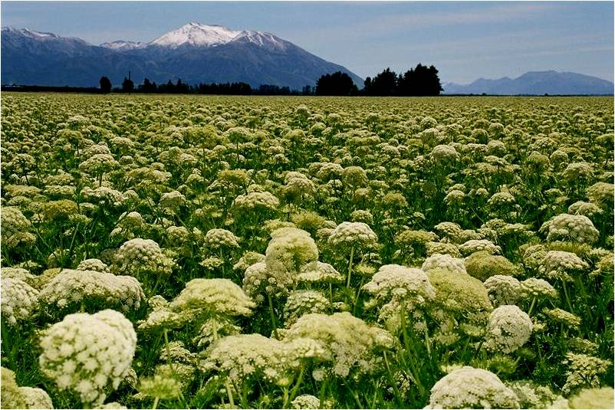
New Zealand’s seed and grain production occupies around 150,000 ha – mainly in Canterbury
around 50,000 ha of this are for seed production
annual seed production is around 140,000 tonnes
major production is pulses > grasses > cereals > forage brassicas > oilseeds > vegetables > forage legumes

Slide 11

New Zealand exported seed to over 60 countries in 2013 … with overlapping agro-ecologies
Seed export value was NZ $192M
Herbage seeds = 53% total export value and vegetable seeds = 47%
Major markets are Australia, Asia and EU – including out of season breeding, testing and multiplication

Slide 12
Contributing to the value of these seed exports are
hybrid vegetable seed production from parent lines supplied by seed companies/ plant breeders in Europe and Asia (New Zealand now supplies nearly 60% of the world’s hybrid carrot seed)
“out-of-season” multiplication of forage and cereal seeds for Northern-hemisphere seed companies
co-operative plant breeding between New Zealand and international companies
This requires world-class seed technology, including breeding, agronomy and machinery (precision planting, harvesting and processing).

Slide 13
The New Zealand seed industry needs more sustainable management practices including
improved crop establishment methods and technologies – to suit special local requirements many of which have wider global application
strategies to mitigate climate change effects
precision agriculture tools for irrigation, fertiliser application etc
improved seed harvesting machinery

Slide 14
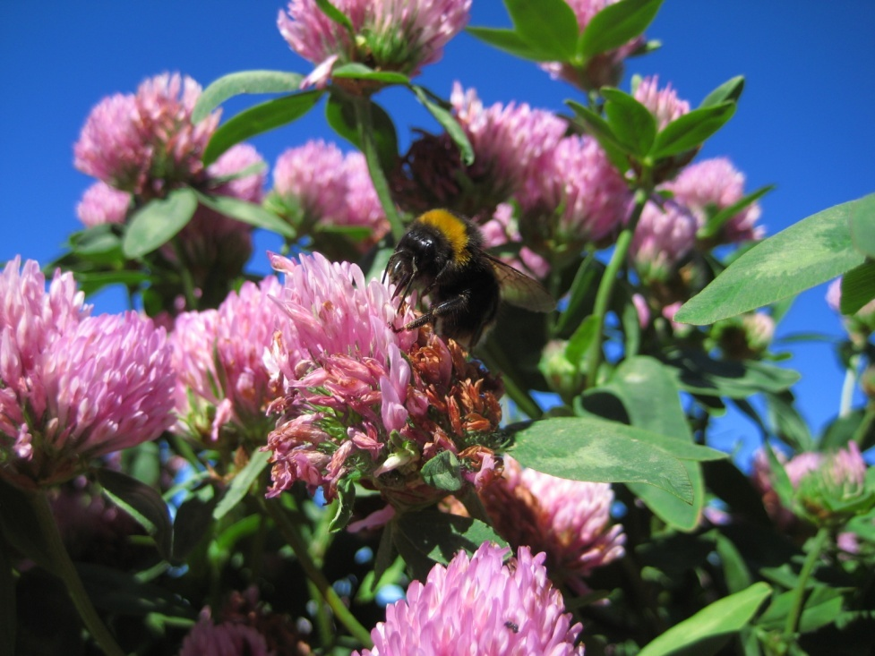
Technical Constraints for Seed Production
Poor pollination and seed set
Pollination efficiency – 30-70%
Seed set – 0-80%
Increased temperature effects on pollinators and pollen viability

Slide 15
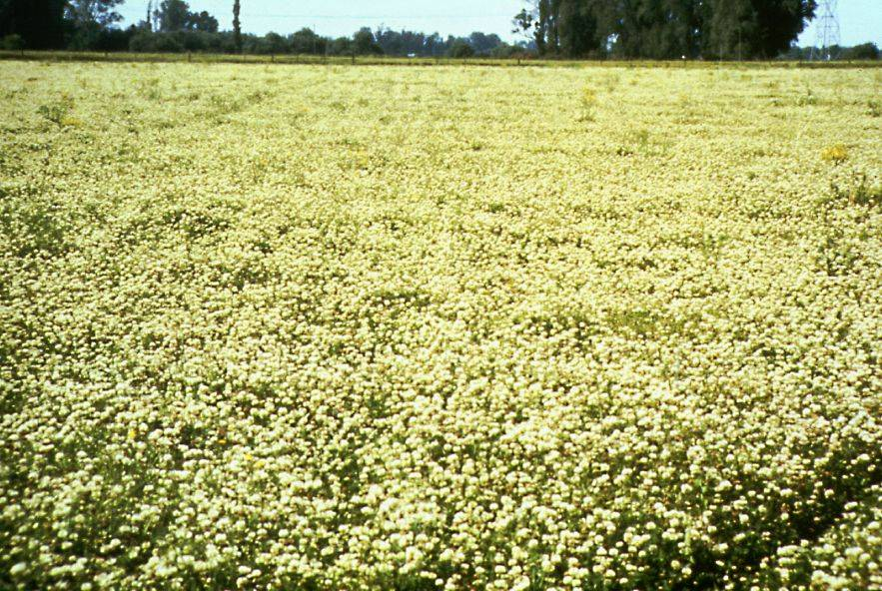
Gap between potential and actual seed yields
Potential seed yield (t/ha)
perennial ryegrass 8.0
tall fescue 9.0
red clover 2.6
lucerne 12.0

Slide 16
3. Understanding of water and nitrogen use efficiency
Relative seed yield and N uptake –
17 trials NZ/OR (* OR/ o NZ)
how much applied N and when?
can urease inhibitors reduce N losses from system?
fertiliser major (55%) energy consumption for seed crop
‘water foot print’ of seed crops

Slide 17
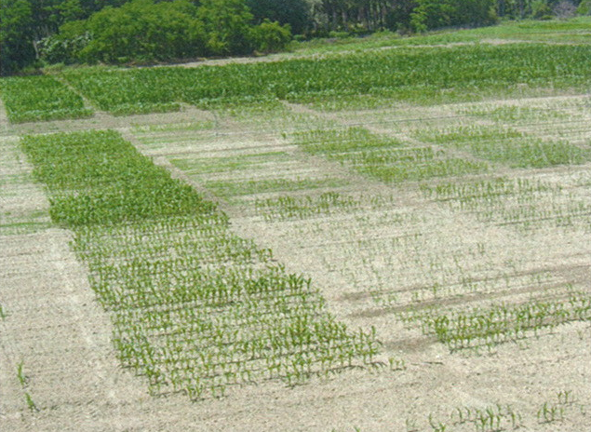
Coping with abiotic stresses affecting seed yield and quality
Increasing temperature likely to:
Reduce seed yields
Reduce germination
Increasingly associated with poor seed vigour in high germinating seed lots

Slide 18
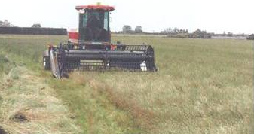
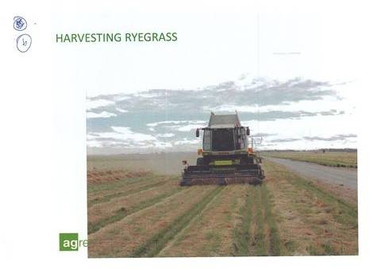
Large harvest losses
Sources of loss (windrow, kg/ha)
cutting 155
in swath 363
pick-up 59
offal 29
Total 606 kg/ha

Slide 19
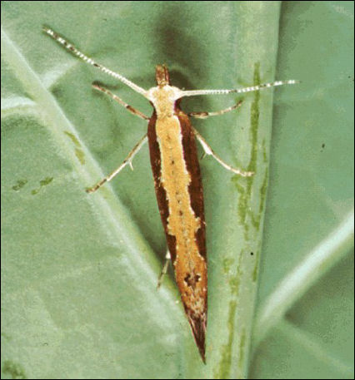
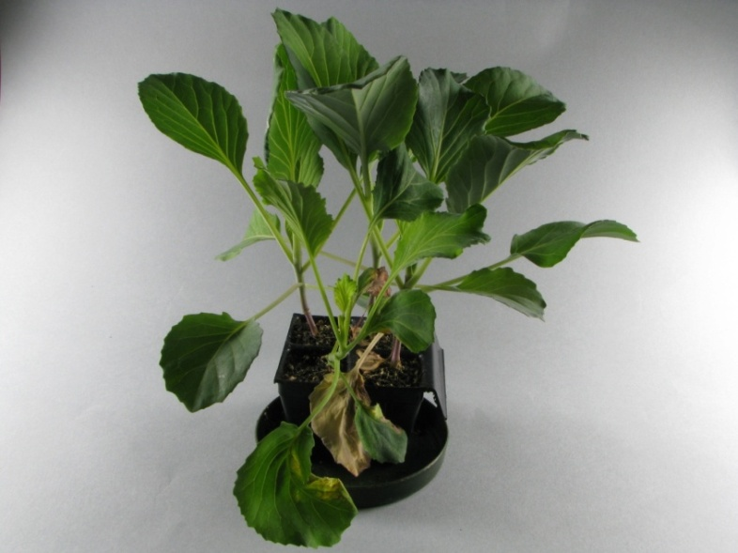
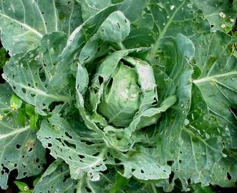
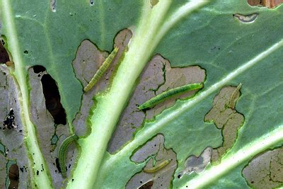
6. Reducing options for chemical control of weeds/ pests/diseases
Black rot –
Infected cabbage seedling
Diamond-back moth
Source: www.ars.usda.gov
- no chemical control
Source: http://thailand.ipm-info.org/
- resistant to all insecticides

Slide 20
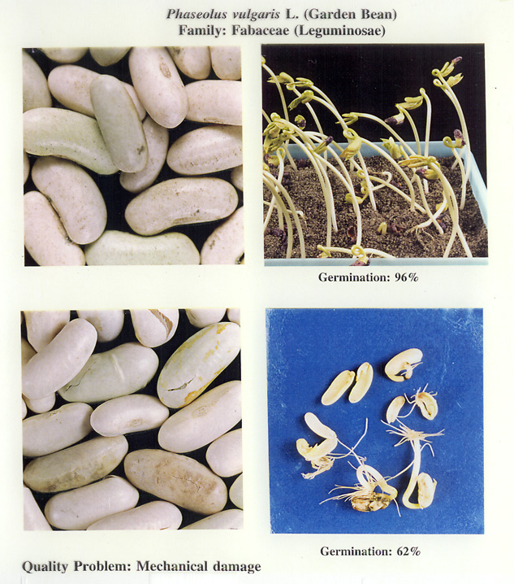
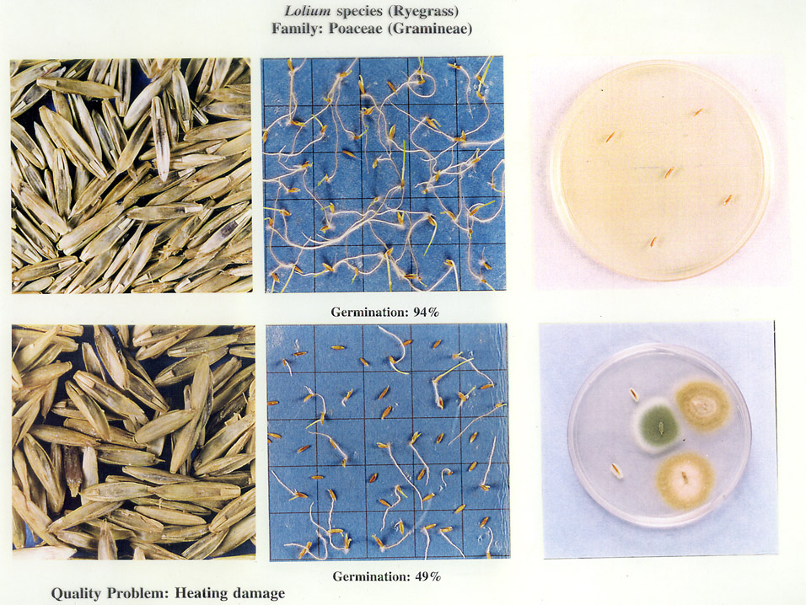
7. Maintaining seed quality post-harvest

Slide 21
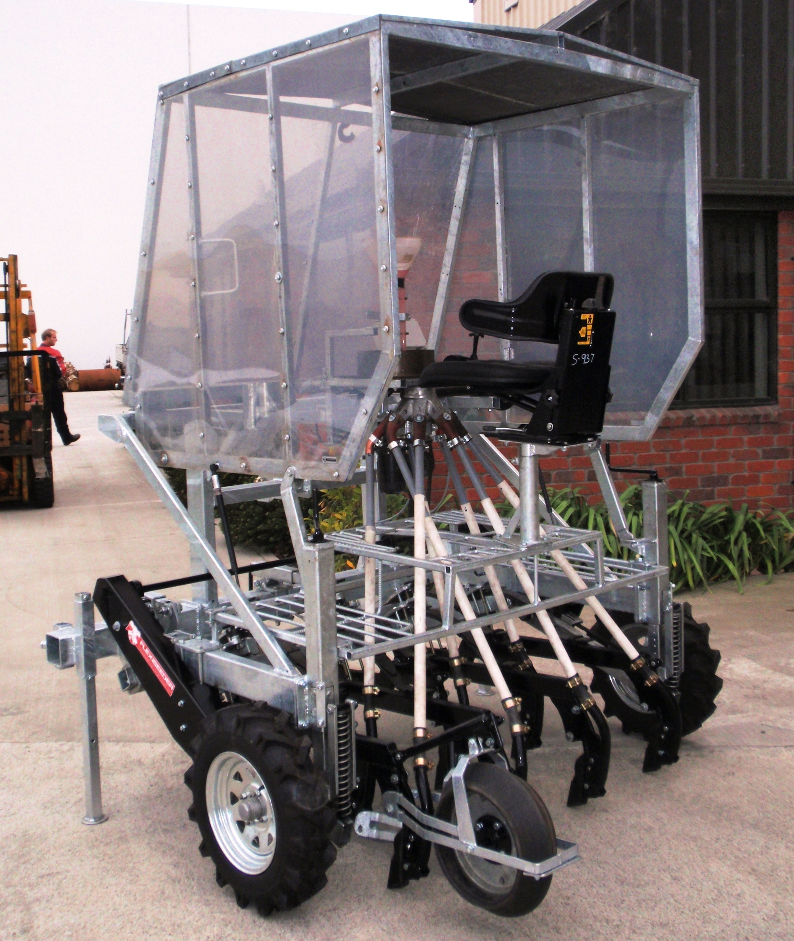
Crop establishment
The environmental and financial benefits of reduced
tillage practices are now well established.
A range of modular light-weight plot/small scale farm scale seeders are now available including Flexiseeder®
Flexiseeder® is a collaborative end-user initiative between IAMFE members, targeting difficult soils with overlapping agro-ecologies
Flexiseeder® modules fit other brands

Slide 22
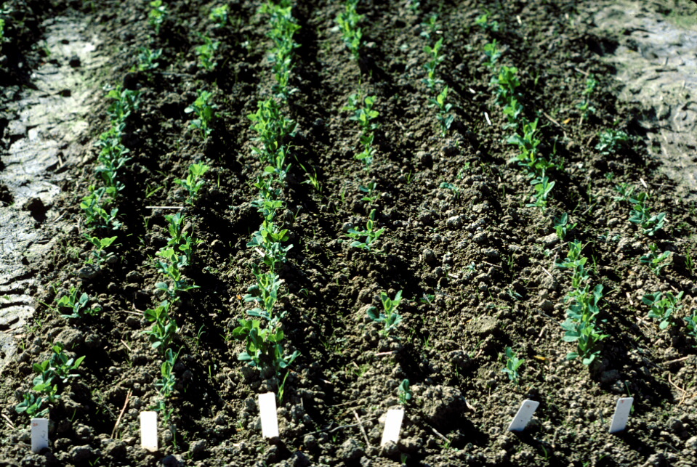
BUT
Reduced tillage can produce a sowing environment that exerts more stress on the seed lot, so that high germinating but low vigour seeds struggle to emerge.

Slide 23
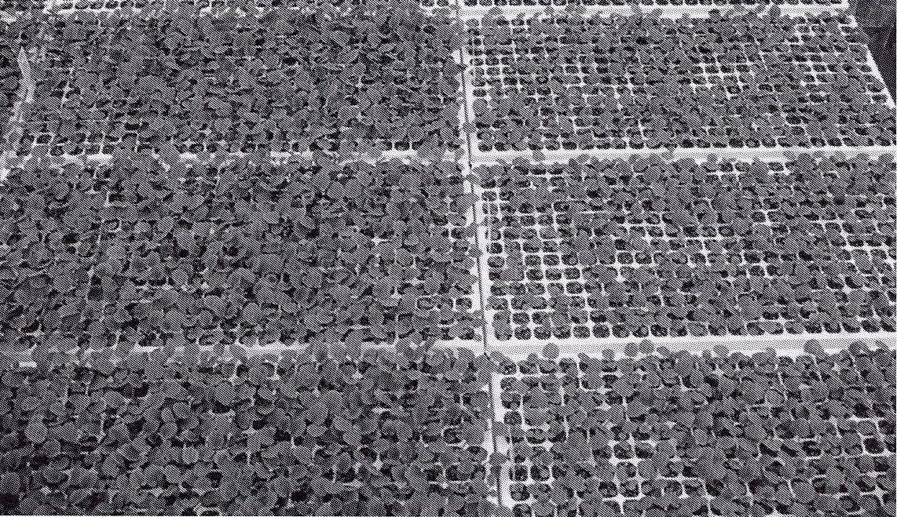
For example, precision sowing requires every seed sown to produce a plant.
Seed lots must be uniformly graded, and have high germination and high vigour.

Slide 24
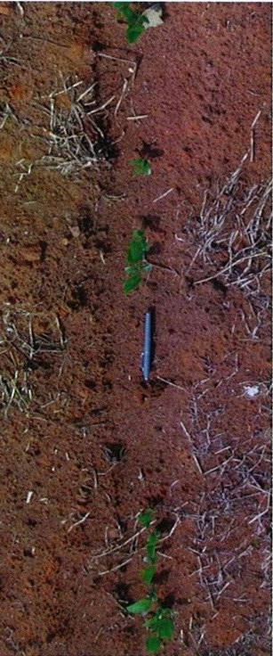
Important Considerations
Germination – as the percentage germination decreases from 100%, the quality of the seed lot declines because the percentage of abnormal seedlings (those not capable of emerging) and/or dead seeds increases.
This indicates the seed lot is deteriorating physiologically and will be likely to struggle to perform once sown.

Slide 25
Germination results and field emergence for five maize seed lots
Seed Lot | Normal Seedlings | Abnormal Seedlings | Dead Seeds | Field Emergence
 | (%) | (%) | (%) | (%)
1. | 96 | 1 | 3 | 89
2. | 88 | 8 | 4 | 76
3. | 75 | 2 | 23 | 52
4. | 64 | 30 | 6 | 50
5. | 52 | 10 | 38 | 21
While the germination test can be a good indicator of field emergence, it cannot explain the differences in field emergence reported for high germination seed lots, especially in the presence of seed bed stresses.

Slide 26
Effect of seed vigour on field emergence of nine forage and nine vegetable brassica seed lots following three hand sowings at the same site¹ (from Leeks, 2006)
 |  | Field Emergence
Sowing No. | Mean 10cm | Forage Species |  | Vegetable Species
 | Soil temperature | Mean | Range | Mean | Range
 | (ºC) | (%) | (%) | (%) | (%)
1. | 4.4 | 72 | 16-92 | 64 | 29-79
2. | 8.7 | 72 | 42-89 | 67 | 55-80
3. | 9.2 | 69 | 6-85 | 79 | 71-87
¹ all 18 seed lots had a germination of 91% or greater

Slide 27
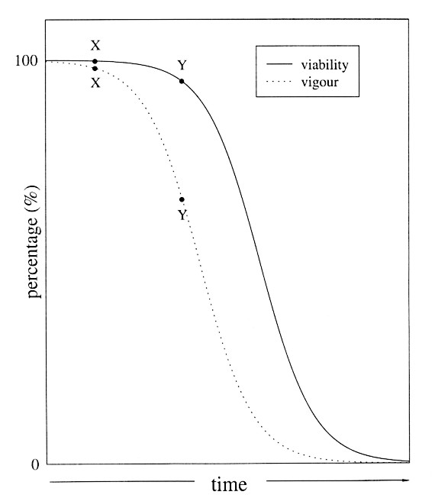
This ability of a seed lot to cope with environmental stresses is called SEED VIGOUR, a physiological aspect of seed quality.
Differences in seed vigour of high germinating seed lots can be explained by the process of seed ageing (or physiological deterioration)
The seed survival curve

Slide 28






