Slide 1
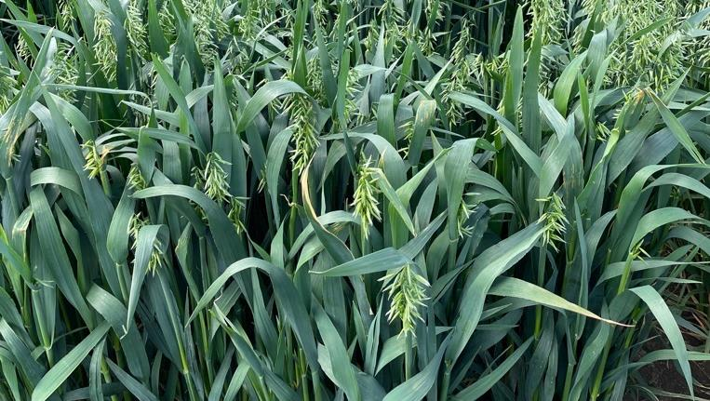
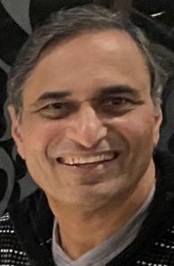


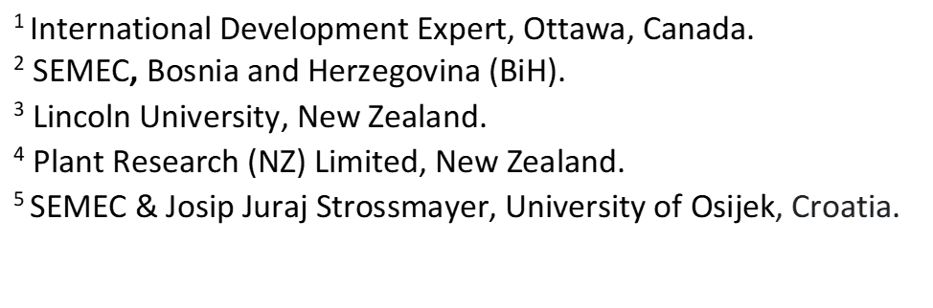
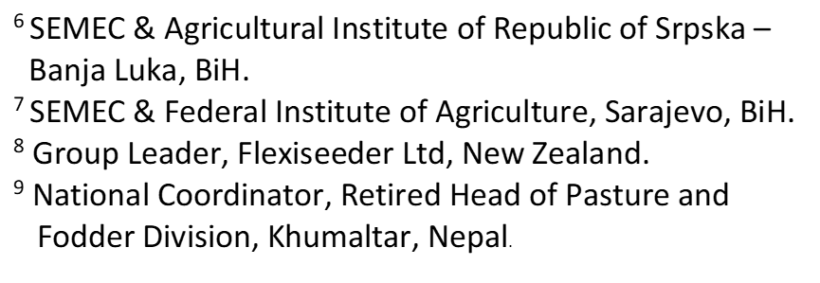
GO CROPDIVA (Global Outreach of CROPDIVA): Optimizing agro-ecological adaptation to mitigate global climate change
A Counter-Season “Shuttle” Breeding Strategy for harnessing value-added
agrobiodiversity synergies with environmental and social change
S.C. Mallubhotla¹, V. Hajdarpasic², H. Alizadeh³, A. Russell⁴, J. Jovic’⁵,
D. Mandic'⁶, S. Kikić⁷, E.J. Stevens⁸, D. Pariyar⁹
Sarma

Slide 2
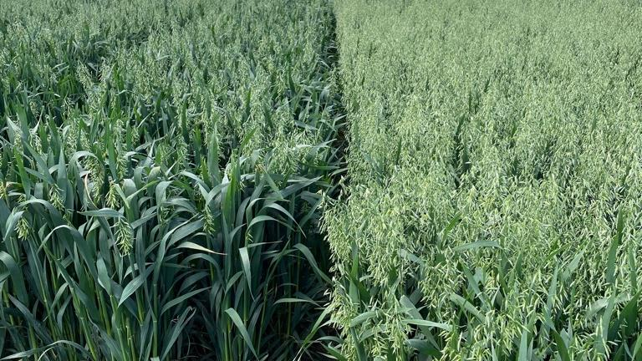
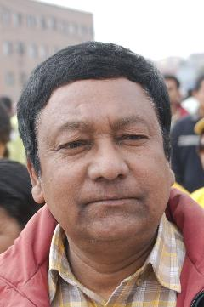
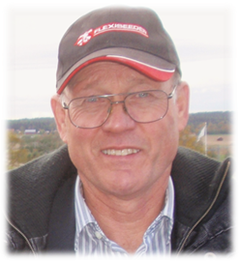
Setting the Scene
Reaching out to CROPDIVA
Dinesh
John
What is Go CROPDIVA?
What is proposed?
What does it overlay to provide structural integrity?
How is the strategy presented by real-life experiences?
What’s our background - 40+ years of working together?
Highlight of our career is the younger generation focus.
Admiration and respect for CROPDIVA – vote of thanks.

Slide 3
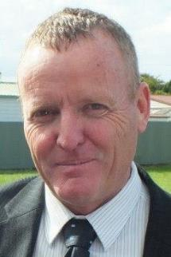

Introduction (Adrian Russell)
Who am I?
What is my collaborative background?
Our work – private, public, commercial output.
Collaborative global network and partnerships.
Explore and develop options within value chains.
Underlying principle and pillar of our Flexiseeder Help Program – reach out, networking & support overlays.
Adrian

Slide 4
Flexiseeder Global Help Group
Global industry research, production and
training help network.
Endowed commercially and philanthropically by sharing members’ technologies and experiences.
Nordic-New Zealand initiative (formed in 1990) between Flexiseeder Ltd (Stevens Family Trust), manufacturing suppliers, plant breeders and end-users of Flexiseeder equipment.

Slide 5
Counter-season “Shuttle” Breeding*
What is it, how does it help?
CIMMYT historic origin – Dr Norman Borlaug.
Virtual global fodder oat improvement centre.
Rapid generational advancement in counter seasons across altitude and latitude sequences ….
Genomic studies, disease screening and deploying marker tests in early generation populations.
* Includes Climate Resilient Orphan croPs for
increased DIVersity in Agriculture (CROPDIVA)
Industry Interface Support Initiative

Slide 6
Our Work
Agro-ecological co-ordinated overlays to year
round seed industry - includes machinery.
Working with private breeding companies and public programmes.
Philanthropic activities via genetics and machinery with value or finance linked to commercial use within the country.

Slide 7
Machinery Overlay
Niche planting and threshing machinery not
otherwise available.
Multi Crop - light-weight - multi-use.
Reduced, zero, conservation and traditional tillage – field plots and small scale production.
Newly constructed, second hand & up-grades.
Complete builds & components for others’.
Identification and sourcing equipment.

Slide 8
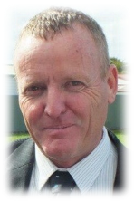
Current spread of NZ fodder oat genetics
Spring sowing: high latitude & continental
Spring & autumn sowing: lowlands
Highland spring and lowland autumn planting in tropics & sub-tropics
Spring & autumn sowing
Shuttle breeding allows more than 1 generation/year across a wide range of environments (ref: Stevens et al, Int. Oat Conf. presentation, Perth Australia 2022)

Slide 9
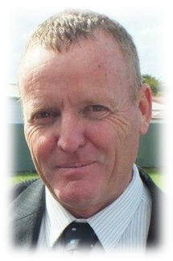

Slide 10
Outcomes: Multi Crop & Multi-faceted, including Machinery
Commercial varieties developed and released.
Global, regional & local seed & food security enhanced.
Projects and programmes identified and supported.
Climate change mitigated & human welfare enhanced.
Philanthropic outreach initiated and achieved in Nepal and the Balkans, for example.

Slide 11
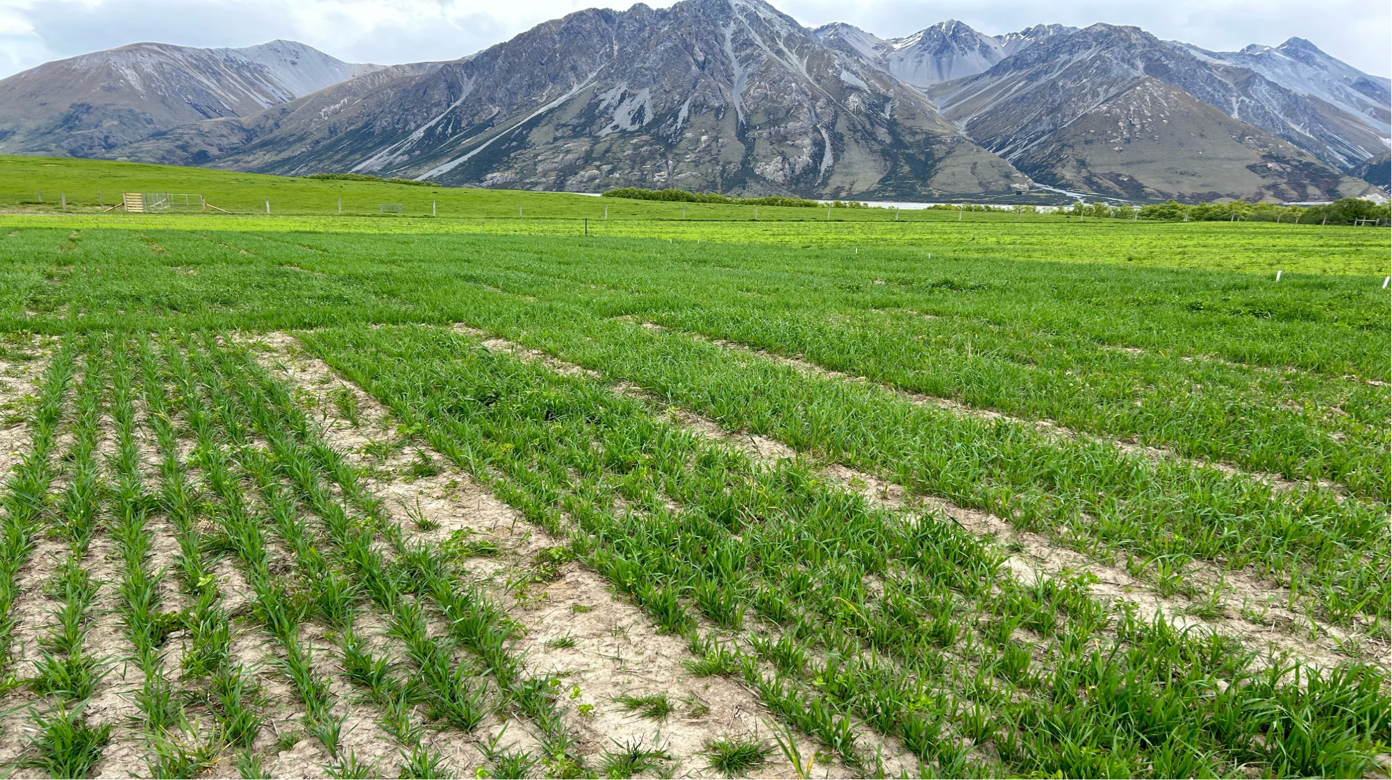

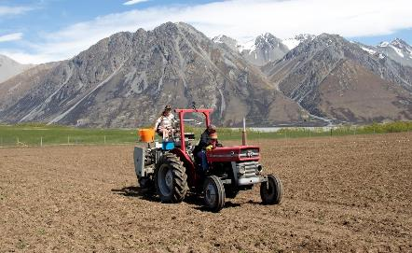
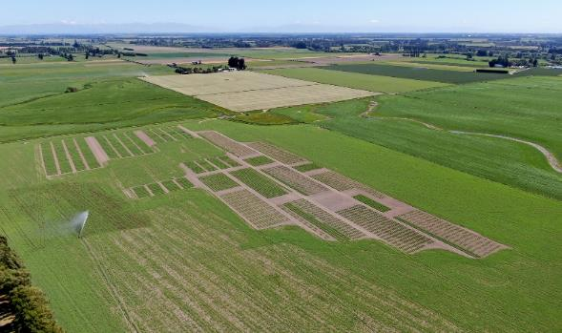
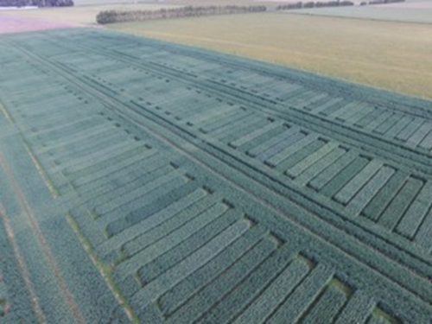
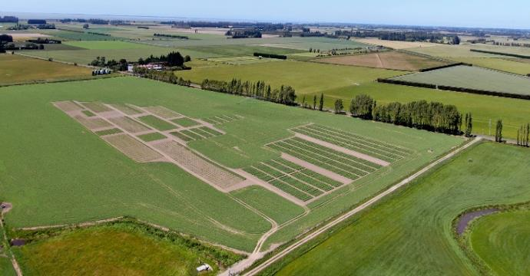
Mackenzie Basin – continental analogue
Photo credit: Ebony Kinney
Canterbury “A”
Gore - Southland
Canterbury “B”
NZ multi-locational nursery network

Slide 12
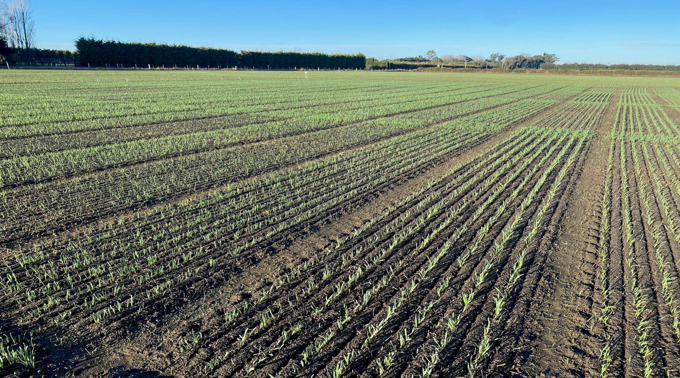
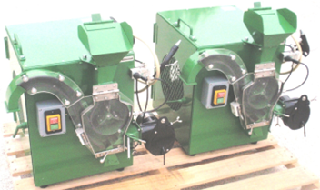


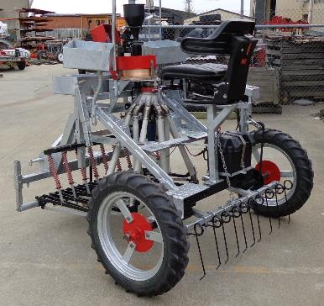
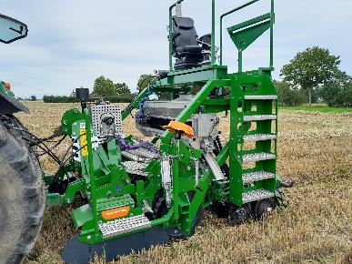
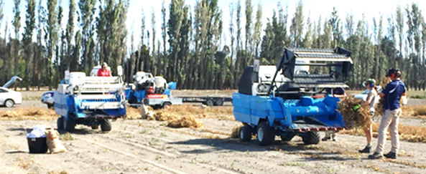
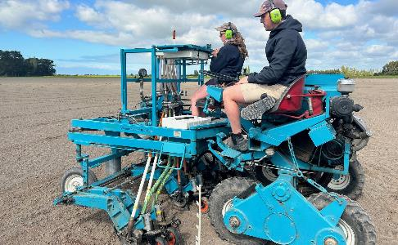
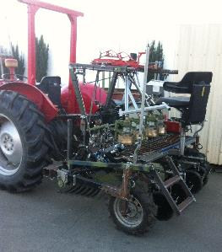
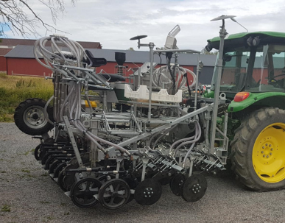
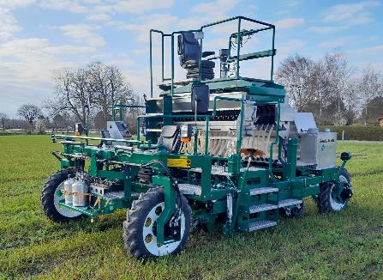
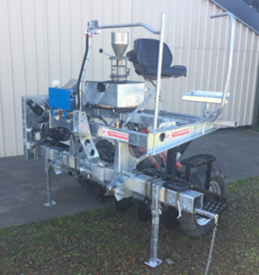
Comprehensive Machinery Support
Designing and Building Small Threshers
www.s-m-v.dk
www.s-m-v.dk
Sourcing Equipment for members
Refurbishing old machines
Suppling modules to other manufacturers
Repairs & Maintenance
Designing and Building Flexiseeders
www.s-m-v.dk

Slide 13
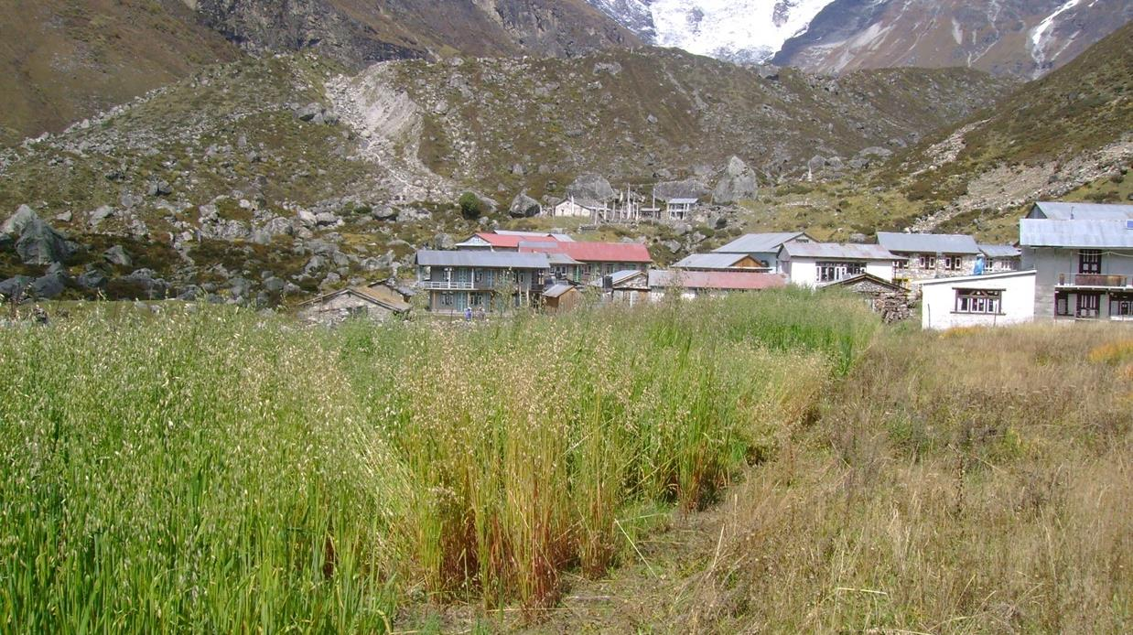
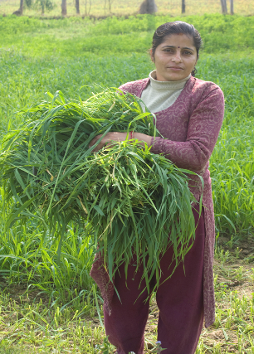
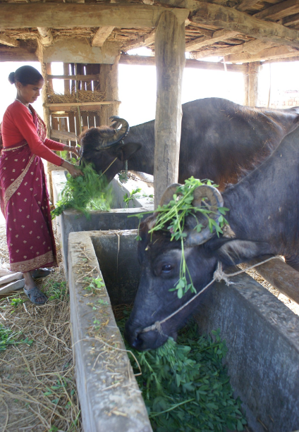
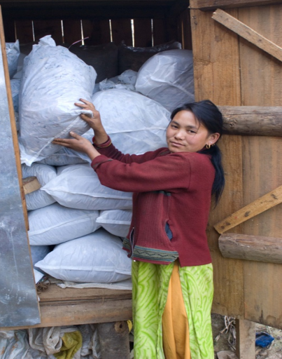

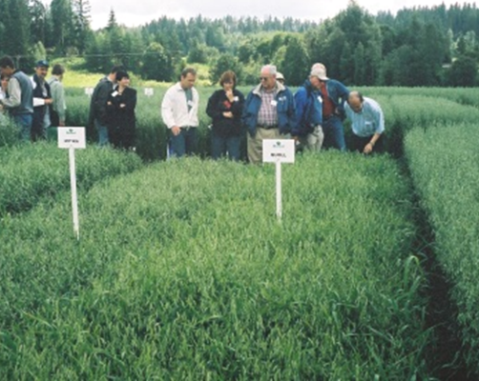

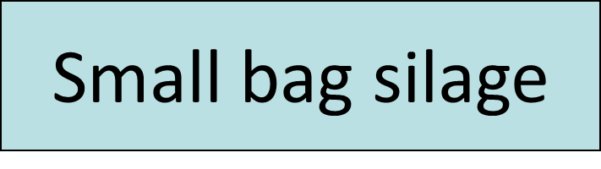

Philanthropic Outreach - Nepal

Slide 14
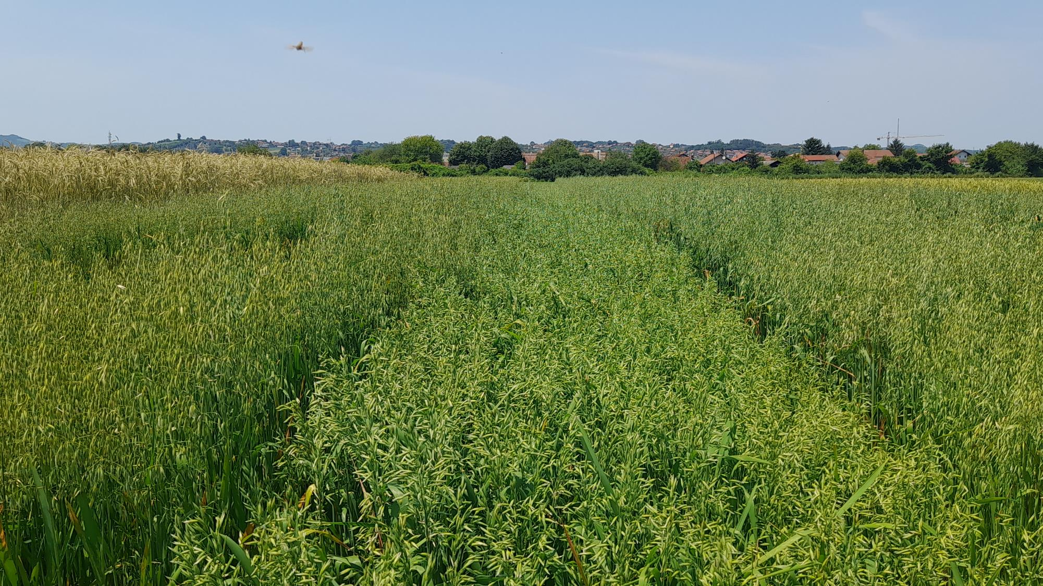

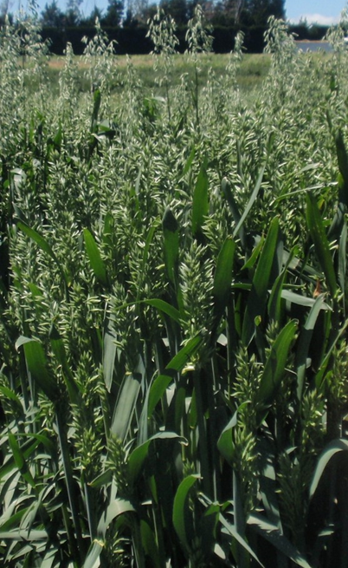
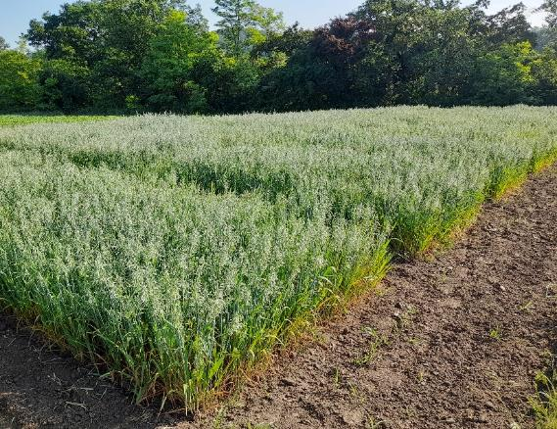
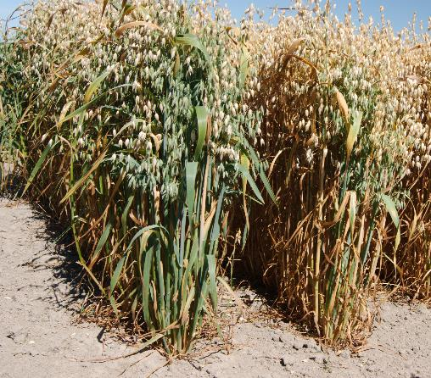
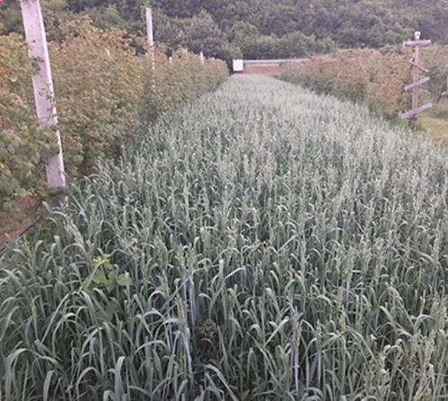
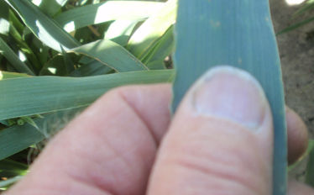
Philanthropic Outreach - Balkans
Venesa Hajdarpasic
Supporting local Livestock Production and Processing Industry
Artisan, Commercial and Eco-tourism
NZ D1
NZ D1
Shuttle-breeding oats with NZ

Slide 15
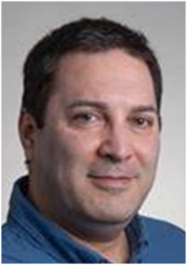
Our Academic side (Hossein Alizadeh)
University Based locally and globally.
Synergies-based, industry-oriented research and training (technical and professional).
Private-public sector collaborative interface foci.
Fields of interest and expertise:
A) shuttle breading and climate change:
Improve resilience of oat to drought stress through identifying early maturing facultative cultivars tolerant to a changing world.
Identify microbial communities under selected cultivars to assess greenhouse (nitrous oxide) emissions.

Slide 16
Academic, continued:
B) Animal Breeding and Climate Change:
  Methane emissions
  Productivity
  Nitrous emissions from urine patches
C) Agro-medical interface
  Investigating linkage between human gut microbiome and depression in people affected by war including refugees.
  Determine whether plant varieties which contain different antioxidants and phenolic compounds can affect gut microbes associated with depression.

Slide 17
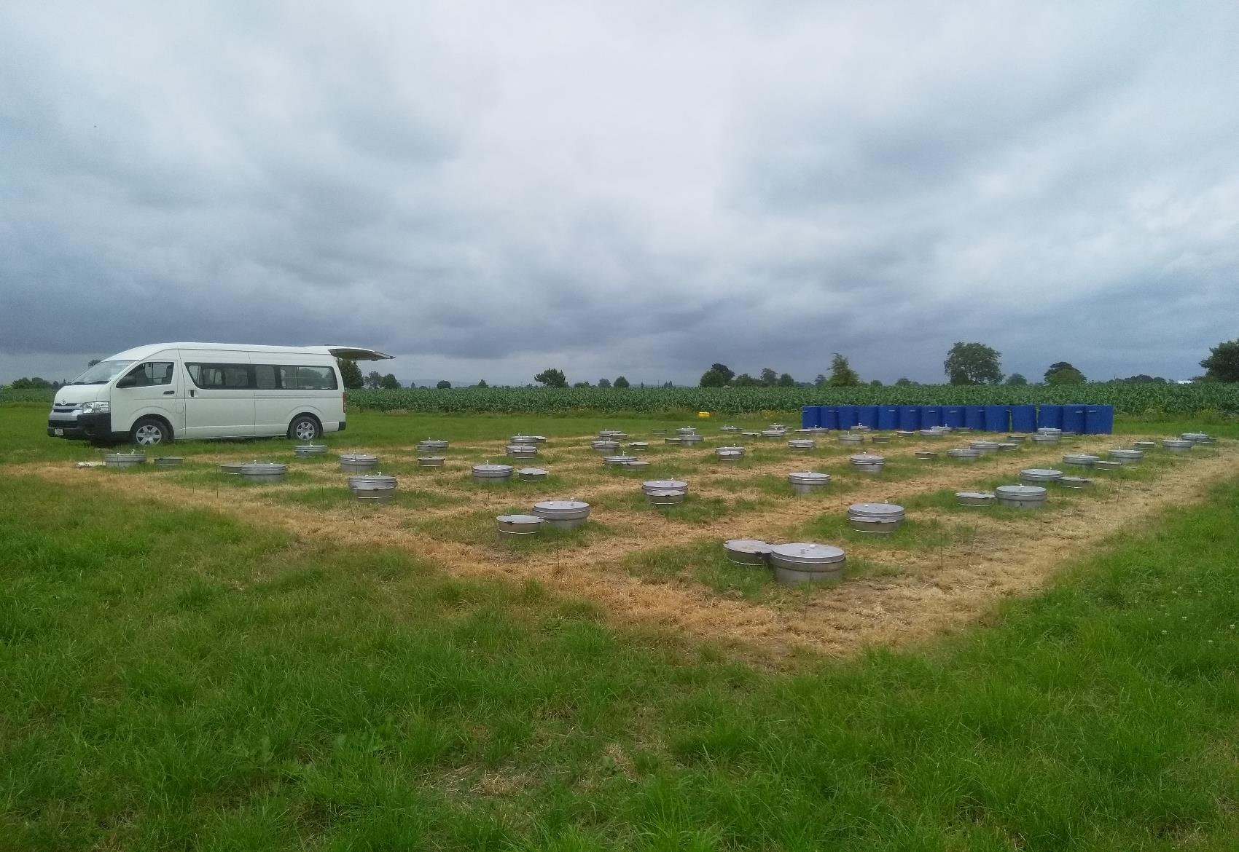


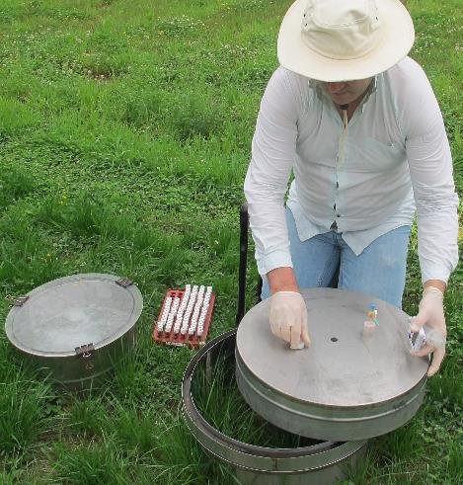
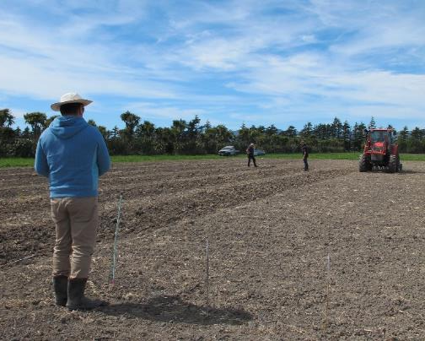
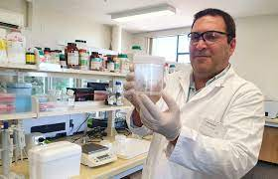
Working together for the Improvement of Important Value Chains: Private – Public Sector Synergies Interface
News Release:
https://www.youtube.com/watch?v=1sAaQE-dXo8&t=1s

Slide 18
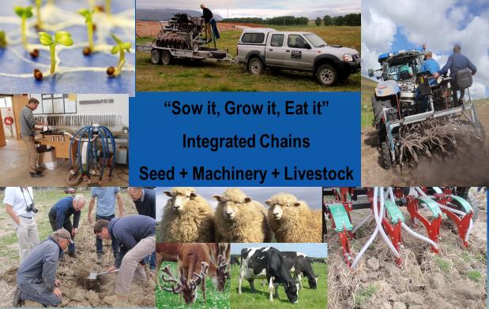
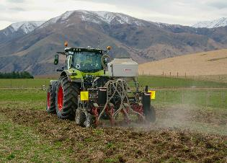
Working together for the Improvement of Important Value Chains: Private – Public Sector Synergies Interface

Slide 19
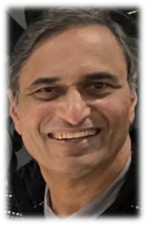
Business & Operational Model (Sarma)
Key points for reaching out:
Create virtual overlays to existing infrastructure in the public and private sectors.
Develop a programme approach comprising of a portfolio of operational global, regional and local “sub-projects”.
Implementation through contracts for goods and services.

Slide 20
Key Points, continued:
Virtual European University-based co-ordination
and support cell, located within the CROPDIVA
network.
Link these to and include additional networks of outreach nodes, locally and globally (NZ, Balkans and Nepal for example) as counterpart entities.
Strong focus on project identification and funding as an integral co-ordination cost of project suites.

Slide 21
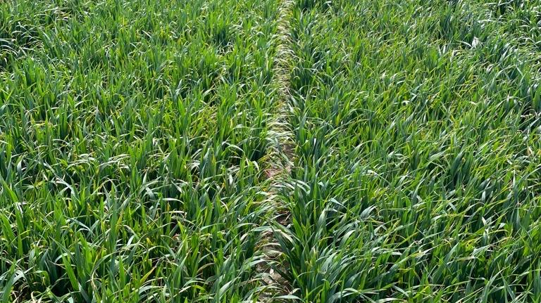

Proposed Example: International Fodder Oat Network (IFON)
including International Nursery (IFONN)
Social enterprise open to public and private sector
New members expected to add germplasm
International Oat Conference Committee, CROPDIVA and Flexiseeder Help Group
Scope for the inclusion of ryecorn, triticale and companion crops
Other countries welcome (dependent on $ support)

Slide 22
Proposed Follow-up, if CROPDIVA accepts:
Team up with at least one EU university in a leadership role within the more developed economies of Europe.
Develop this as a co-ordination centre and focal point for consortia, project and programme formulation and donor interfaces.
Issue a global call for expanded membership and participation.

Slide 23
Proposed Follow-up, continued:
As a consolidated consortia team, collectively:
  Expand the “start-up” base by targeting expanded EU, UN, and other Government, Donor, and investment funding sources in the public and private sectors.
  Approach the Gates Foundation, World as well as regional banks, Aga Khan Foundation and Tata Trusts, for example.

Slide 24
Proposed Follow-up, continued:
Our proposed initiatives incorporate and build
on value-added synergies in a novel way.
This target the EU Horizons Synergies Programme from NZ as well as Europe, including EU funding at local country levels as a core starting point.
From this base we shall apply more widely for theme and non-theme-based grants.

Slide 25
Acknowledgement and Vote of Thanks from Team Leader
Conceiving and developing the foundations for Go CROPDIVA was a collegial team effort,
inspired by our respect for what the CROP DIVA Project stands for and has achieved, providing
a case study with global application.
We would not have reached this point, had it not been for the collective inspiration,
mentoring and support of Ms Charlene Wight, Dr Geert Haesaert, Dr Greet Verlinden,
Dr Steffen Beuch, Prof. John Hampton, Mr Keith Armstrong, Prof. Derrick Moot, Dr Nick Tinker, Dr Catherine Howarth,
Mr Nishant Shandilaya, and Prof. Colin Campbell, James Hutton Institute, Scotland.
Contributions from members, essential to developing support overlays including seed and machinery is gratefully acknowledged, encompassing but not limited to: Torbjörn Leuchovius (ret.) SLU, Upsala, Sweden; Karl-Johan Langvad; Geoff Gray, Austin Booth, Alan & Ben Friel; Travis Ryan-Salter; Jens Jensen & Morten Nygard; Noel Collins & Ian Close; Jason Harber & Stuart Mclellan; Paul Young; SLU Field Research stations (Lanna/Röbäcksdalen/Alnarp/Lövsta); Field stations of the Swedish Agricultural Societies (HS Konsult/ Halland/Skåne/Gotland/Skaraborg/Östergötland); Swedish Lantmännen breeding stations (Svalöv/Bjertorp/ Lännäs); Tibor Molnar; Ram Ghimire, Kishor Shrestha (ret.) & Sunita Sanjyal, Nepal Agricultural Research Centre; Vojislav Trkulja, Miloš Nožinić & Miljan Erbez, Agricultural Institute of Republic of Srpska, BiH; Mirsad Mujković, Federal Institute of Agriculture, Sarajevo, BiH; Dean Krunoslav Zmaić, Faculty of Agrobiotechnical Sciences Osijek, Croatia; Marko Maričević, Bc Institute, Zagreb, Croatia; Mariana Andreuccii & Pieter-Willem Hendriks, Lincoln University; Stevens, Fastier & Zürrer Families; Gerhard Ondrej.
Any questions?
Email: stevensj@flexiseeder.com

